Slide 2
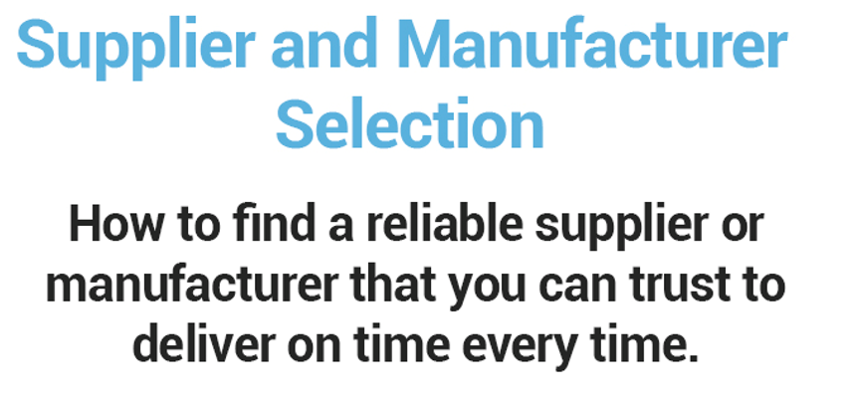
Our Buying Secrets
Webinar 14

Slide 3
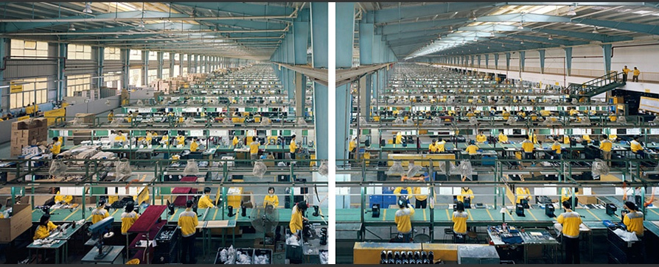
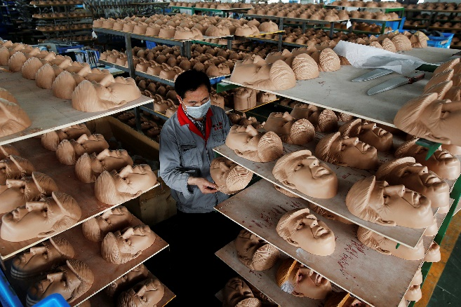
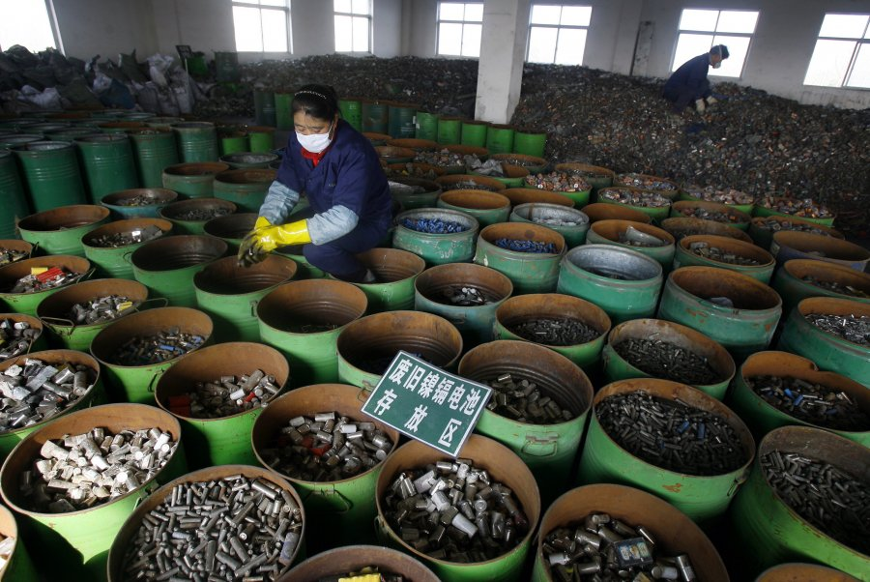
It’s all about the “Perfect Match”…

Slide 4
Where to begin finding your Perfect Match!?
Google search for suppliers in your industry of choice and your preferred location (e.g. Metal fabrication Taiwan)
Visit Alibaba and look for similar products and materials usage.
Contact the chamber of commerce related to your consumer market and manufacturing country
Go to trade shows and trade events that feature your product, similar products or similar industries
Contact a broker (beware that this can add cost but is also sometimes unavoidable due to other market conditions such as language or local law)

Slide 5
What is a Perfect Match?
A supplier that values your business, is proactive and responsive
A supplier with expert knowledge, experience and longevity.
A supplier in the right industry, in the right country, in the right area
A supplier of the right size and scale to support and grow with you
A supplier that scores a 5 or above on the Supplier Selection Checklist is a good potential supplier (we will get to this later)

Slide 6
A supplier that values your business and is proactive and responsive.
Does your supplier respond promptly to emails or missed calls and answer all of your questions clearly?
Does your supplier follow up if you don’t reply back?
Does your supplier explain their business in a way that you understand and highlight points critical to your product? (i.e. supply or material issues)

Slide 7
A supplier with expert knowledge, experience and longevity
How long have they been in business and how stable are they?
What level of experience do they have with your materials and assembly?
Do they have in-house expertise that can help develop your product?

Slide 8
A supplier in the right industry, in the right country, in the right area
Do local laws or trade agreements with other countries benefit you? (raw materials and product)
Is there any activity from the government to support the industry? (tax law, cheap land in good areas as examples)
Are they near to a port or airport? Are they near to their raw materials suppliers?

Slide 9
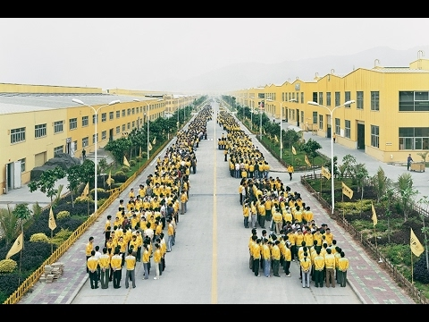
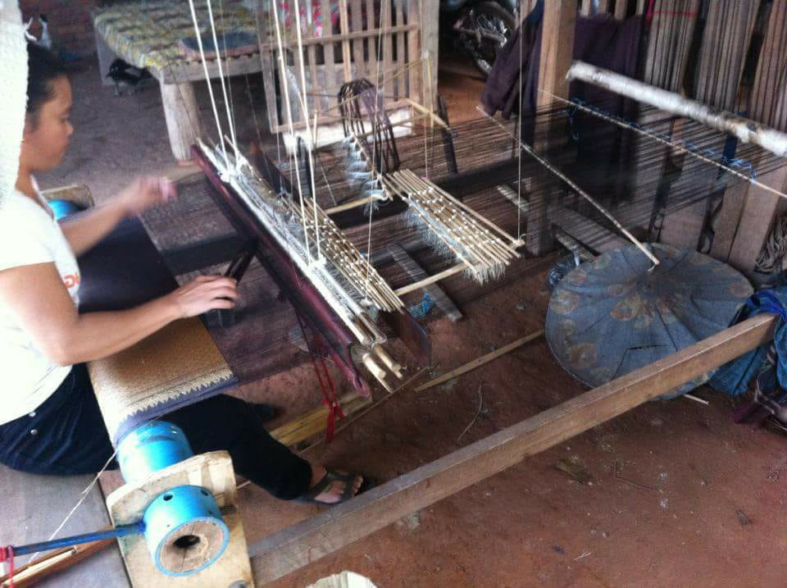
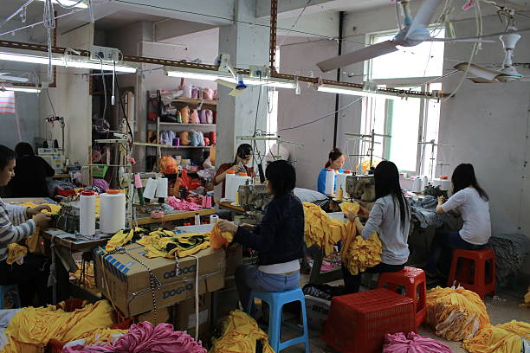
A supplier of the right size and scale to support and grow with you (the goldilocks principle)
Not too Big!
Not too Small!
Just right!

Slide 10
Supplier Selection Checklist
(See template)

Slide 11
Be Prepared! The more info you have the better:
Take a similar product or sample with you to help discussions
If your design is sensitive take a Non Disclosure Agreement (NDA)
Define your product specifications (Drawings, CAD, Bill of Materials)
Think about the critical quality features of your product and what is acceptable or not acceptable. Define these as well as possible
Have an open mind

Slide 12
Q & A

