Slide 2
Our Buying Secrets
Webinar 17
WELCOME!

Slide 3
GO!
Shipping & Logistics

Slide 4
Freight Companies that get the job Done!
GW international Shipping Email: sale4@gwocean.com Name: Anson Phone: +86 138 2847 5332 | Hellmann Shipping http://www.hellmann.com.au/australia/ Email: dstone@hellmann.com.au Name: David

Slide 5
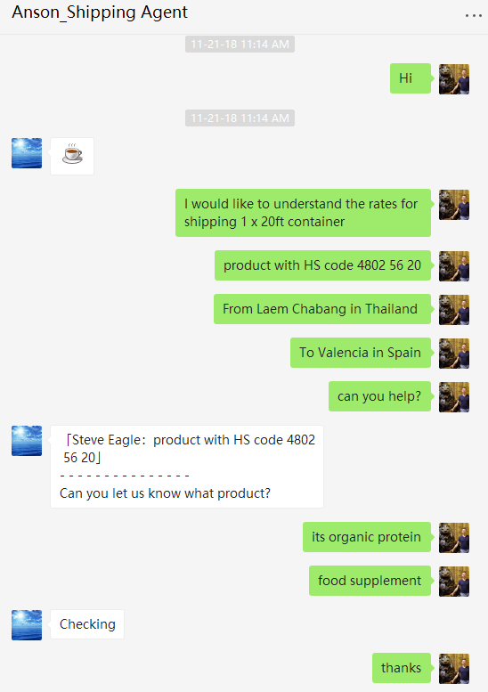
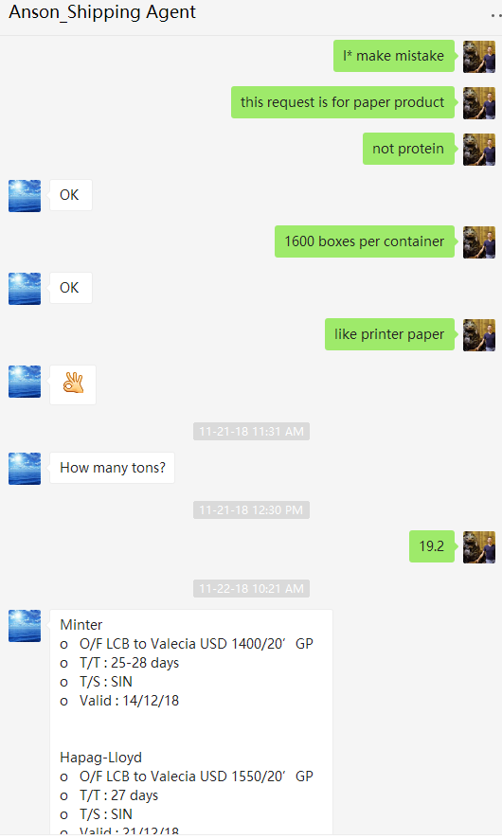
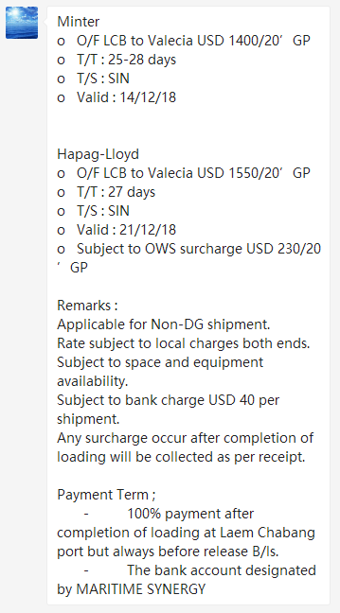
What to Expect:
1. | 2. | 3.

Slide 6
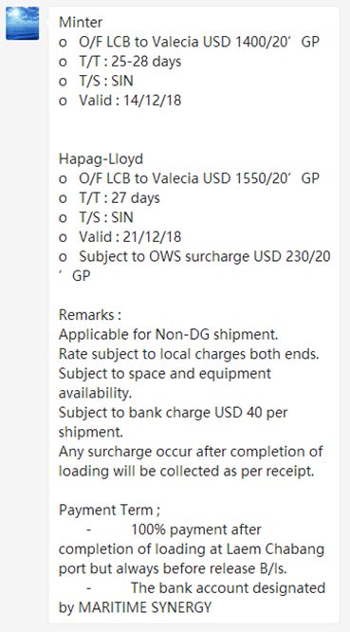
Wait… what?!
2 Quotes:
Minter
Hapag-Lloyd
Conditions & limitations:
Terms may vary
Provide as much detail as possible
Payment Terms:
Terms may vary
Sometimes flexible for special requirements

Slide 7
JARGON ALERT!!
Common Terms:
O/F = Ocean Freaight!
T/T = Transit Time
T/S = Temporary Storage
Valid = Quote Window
Conditions & limitations:
OWS = Overweight Surcharge
Non-DG = Non Dangerous Goods
Standard clauses (freight forwarder)

Slide 8
Other Common Jargon to Know
HS Codes:
Harmonized Commodity Description and Coding System
A number used to describe roughly 5300 products, articles and raw materials
Used to identify correct duty taxes and customs law
Find them here: https://www.findhs.codes/
Incoterms:
15 international commercial terms used to define the roles of the buyer and seller for international trade
Reviewed every year by the international chamber of commerce (ICC)
Lets take a closer look…

Slide 9
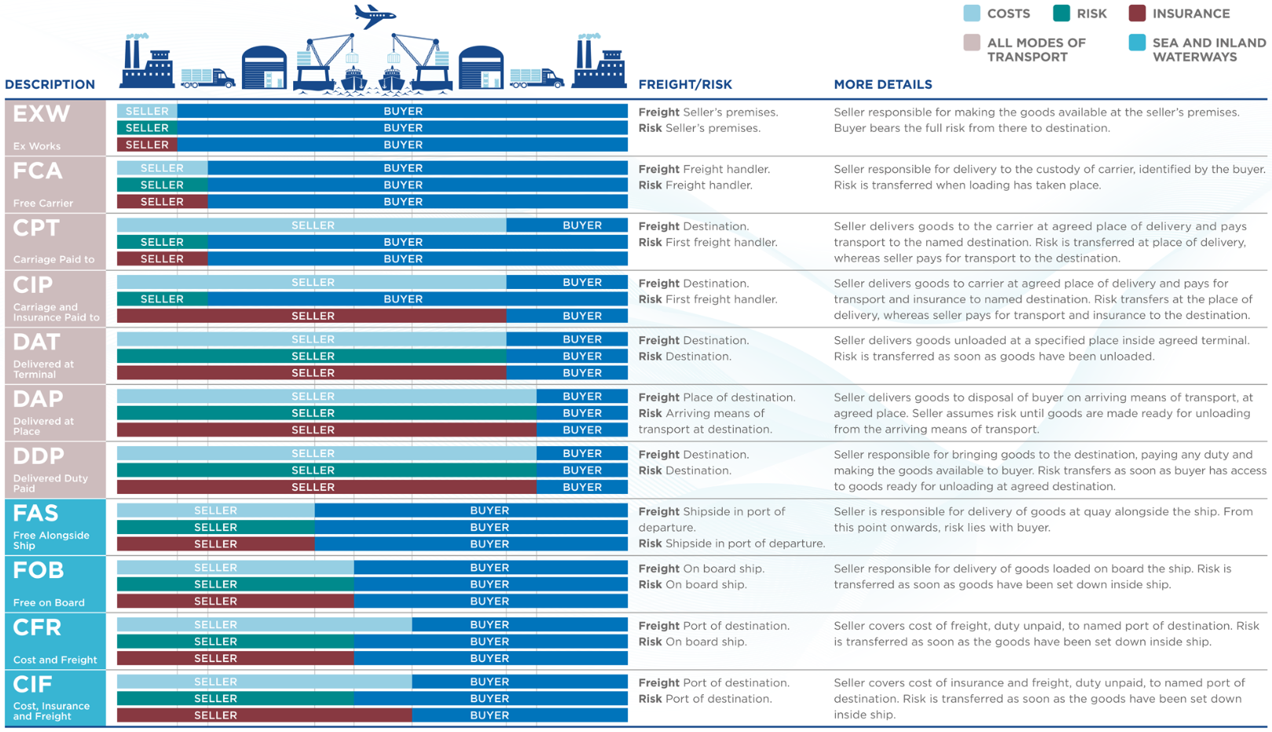
Incoterms Explained

Slide 10
5 things to get right every time:
Identify the Incoterms and UNDERSTAND them
Have a single point of contact for each company involved
Share all paperwork with all parties (be specific how to share)
Understand the Import Law (HS code)
Quote early, ship early (sometimes delays happen that are no-ones fault)

Slide 11
Q&A
Thanks for Joining!

